Slide 1
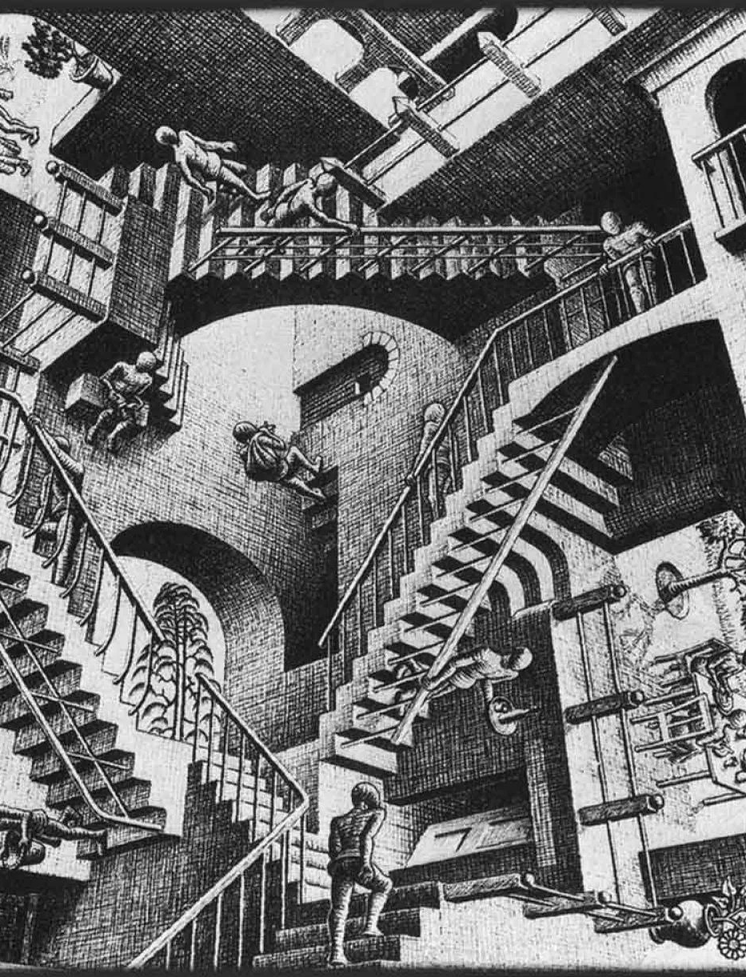

Tesi di Laurea Magistrale in Matematica
Topos Semantics for 3-valued Gödel-Dummett Logic
Author: Alberto Panerai
Supervisor: Prof. Stefano Aguzzoli

Slide 2
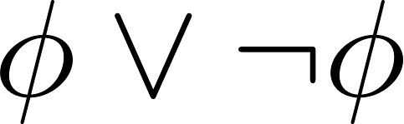

Gödel-Dummett Logic
In a nutshell,
Intuitionistic Logic is Classical Logic without the «Law of Excluded Middle».
An Intermediate, a.k.a Superintuitionistic Logic, obtained by extending Intuitionistic propositional Logic with the «pre-linearity» axiom.

Slide 3
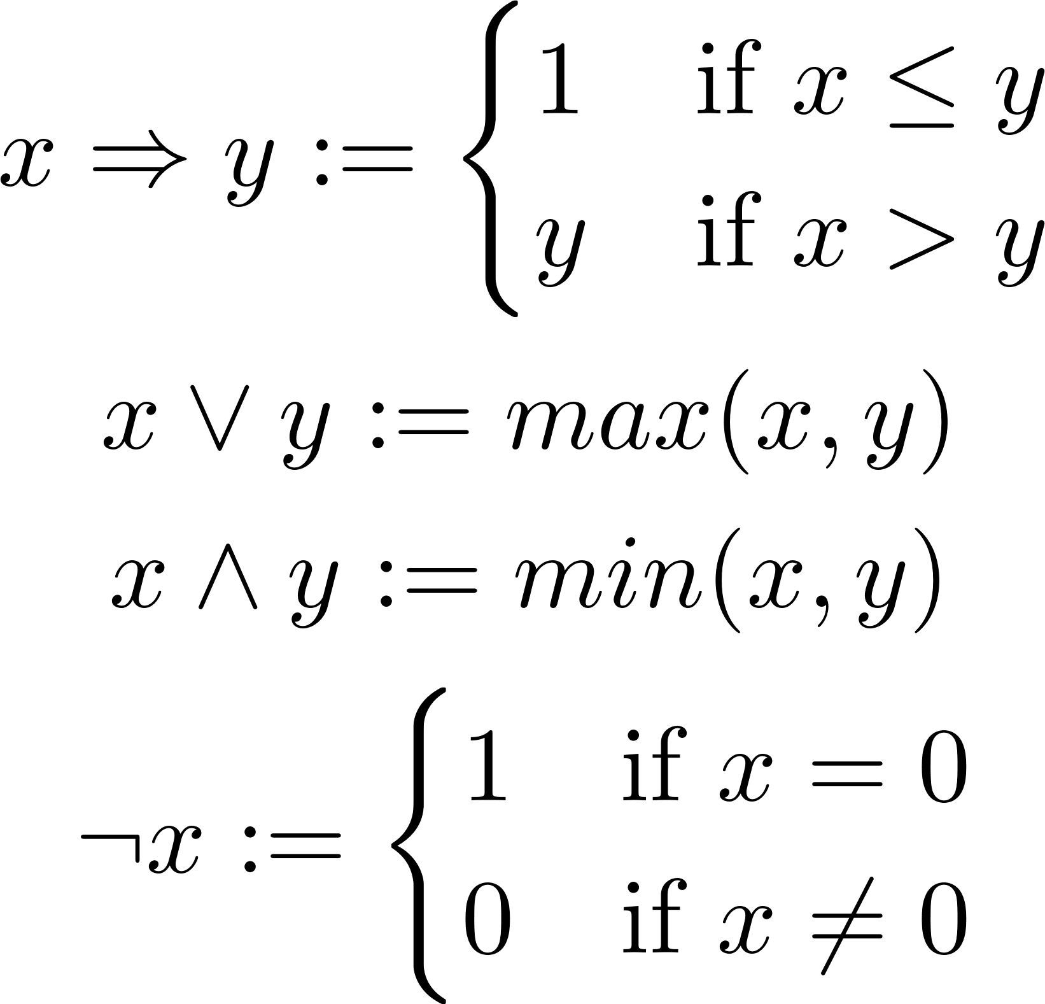
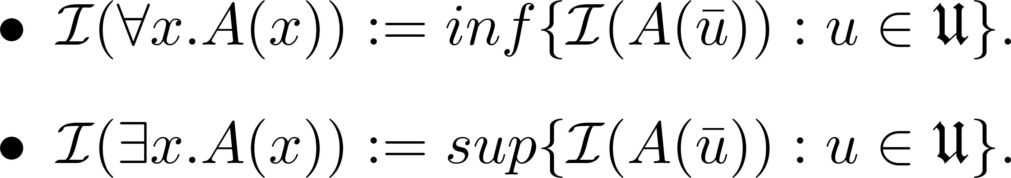

Algebraic Semantics
Propositional semantics:
First Order extension:

Slide 4
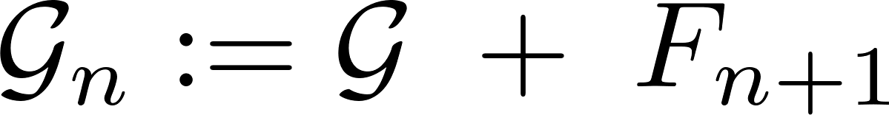
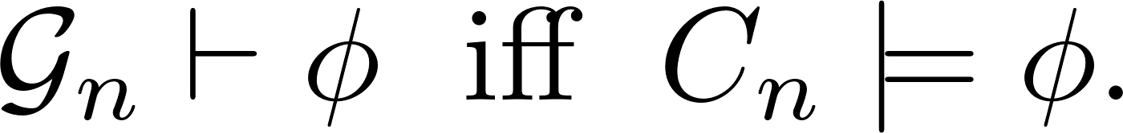
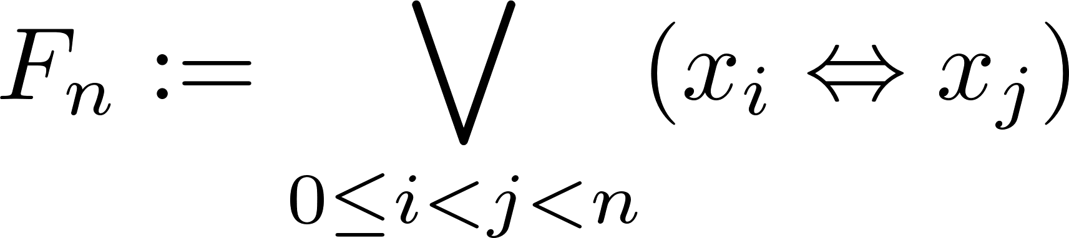
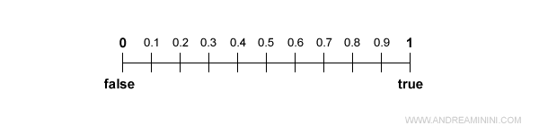
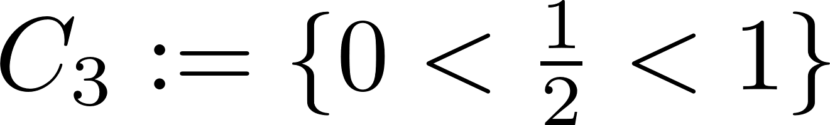

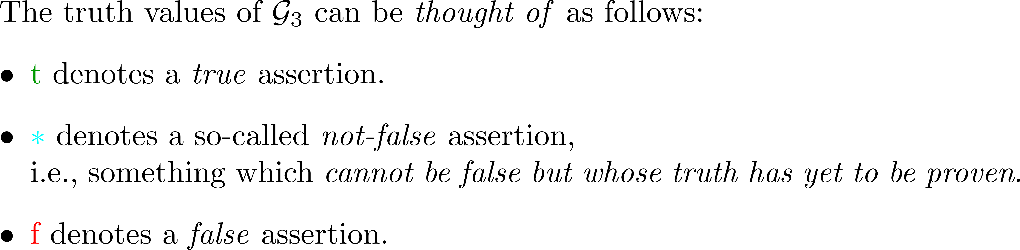



Finite-valued Gödel-Dummett Logic

Slide 5


Finite Forests

Slide 6
Finite Forests and Sub-forests
Caveat:
The nodes are ordered bottom to top.

Slide 7
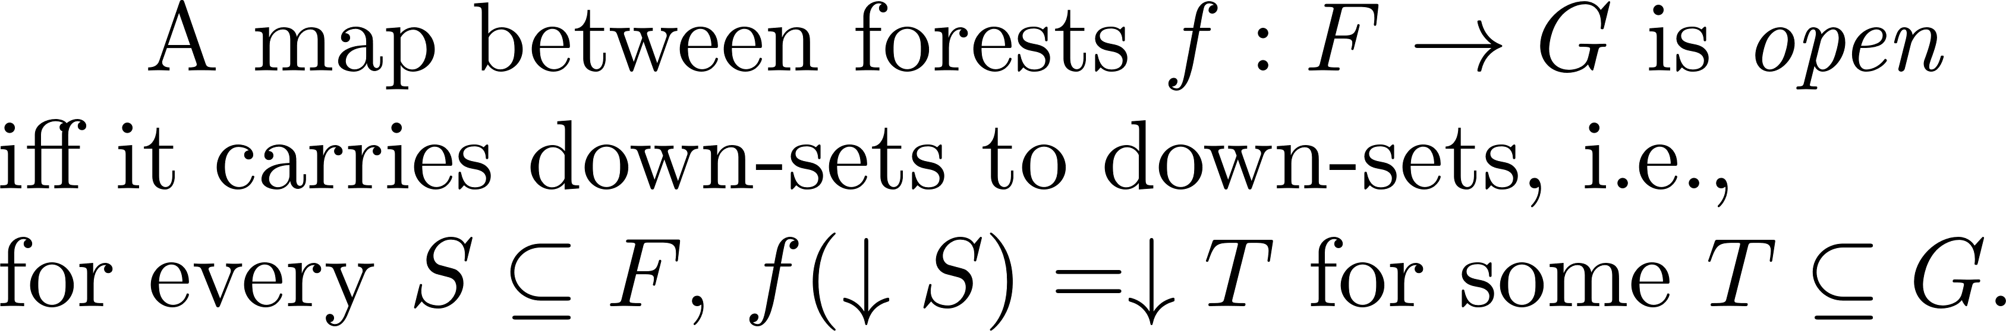
Category of Finite Forests

Slide 8

Terminal, co-product, etc..

Slide 9

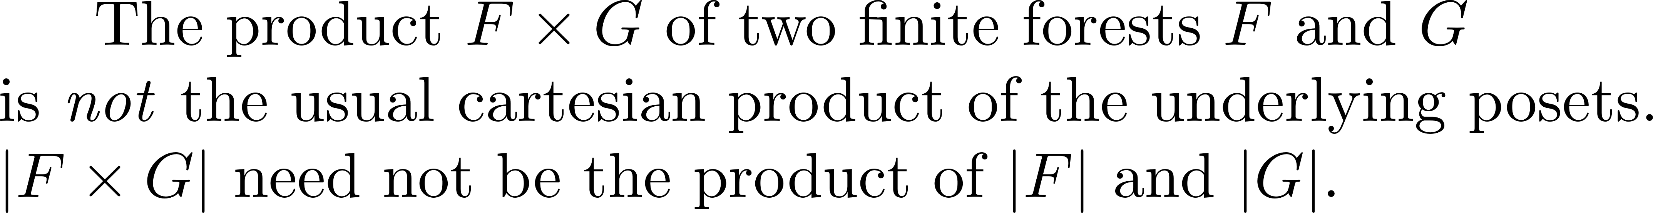
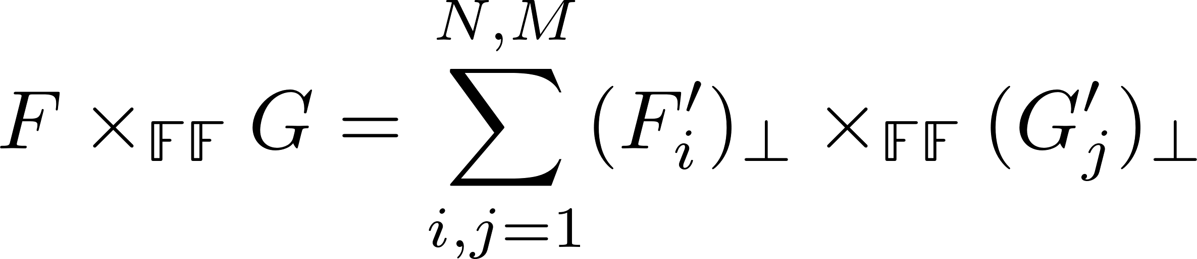
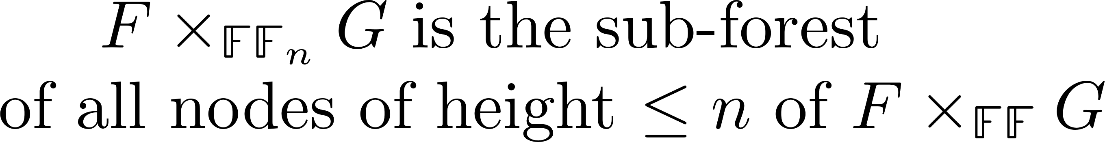
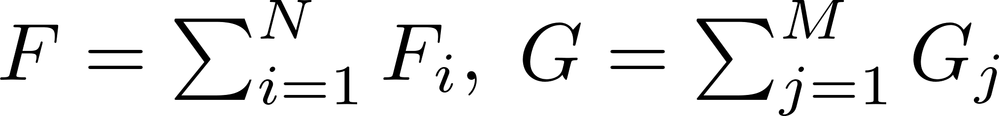
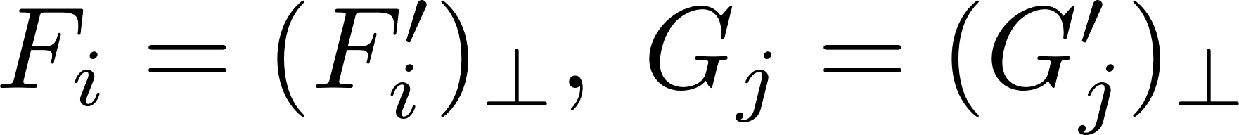
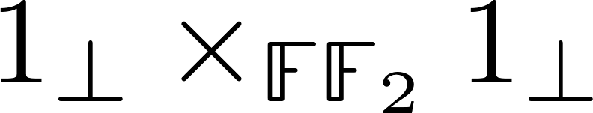
Products
Warning

Slide 10
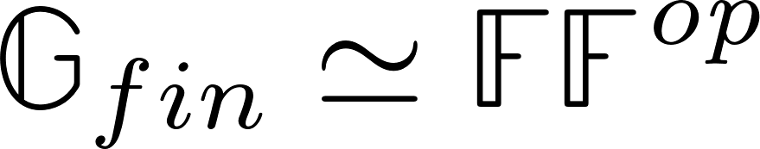

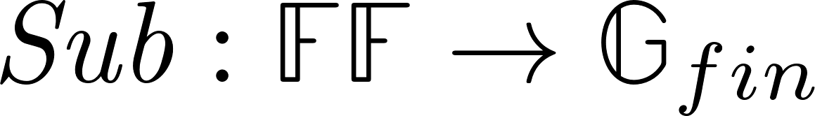
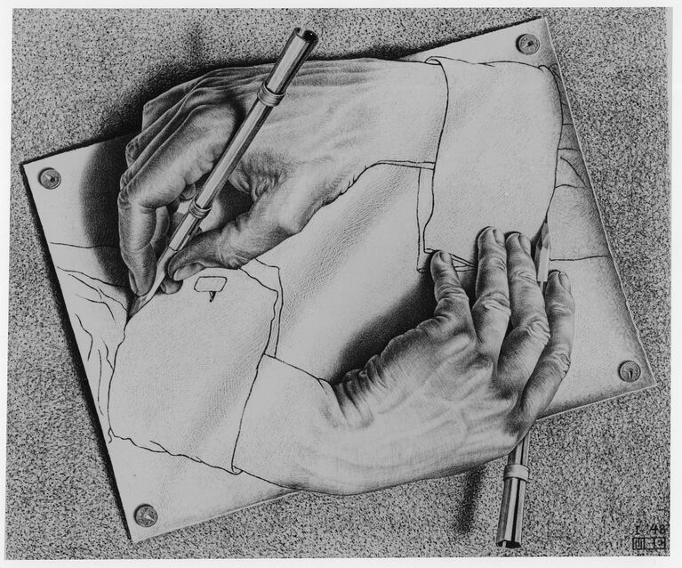
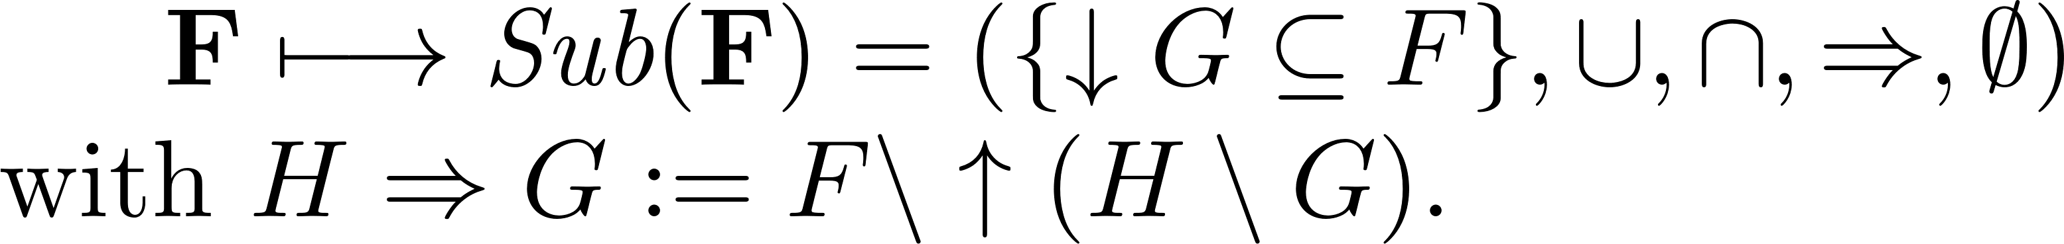
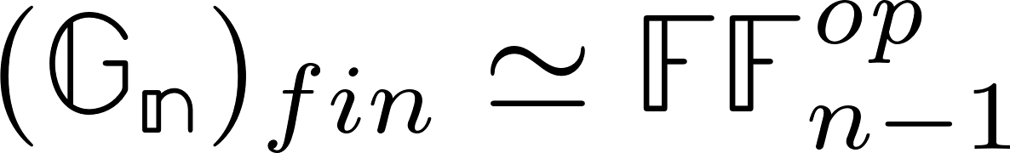
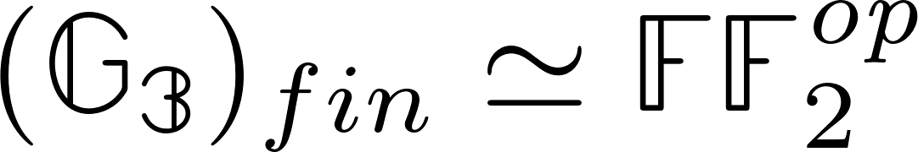
Duality
We make use of finite spectral duality between finite Gödel algebras and finite forests.

Slide 11
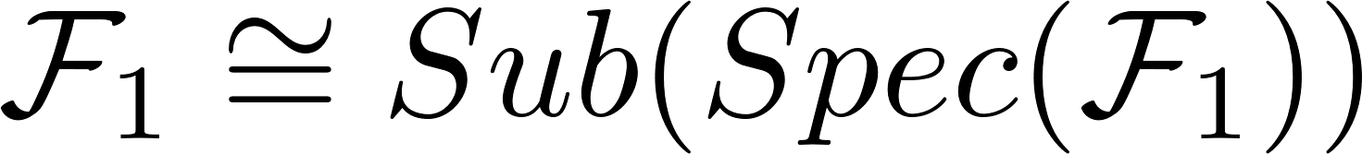


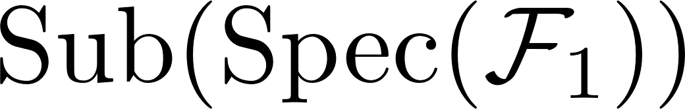
Algebras and Forests

Slide 12

Sub-object Classifier
The sub-object classifier for finite forests is given by:

Slide 13
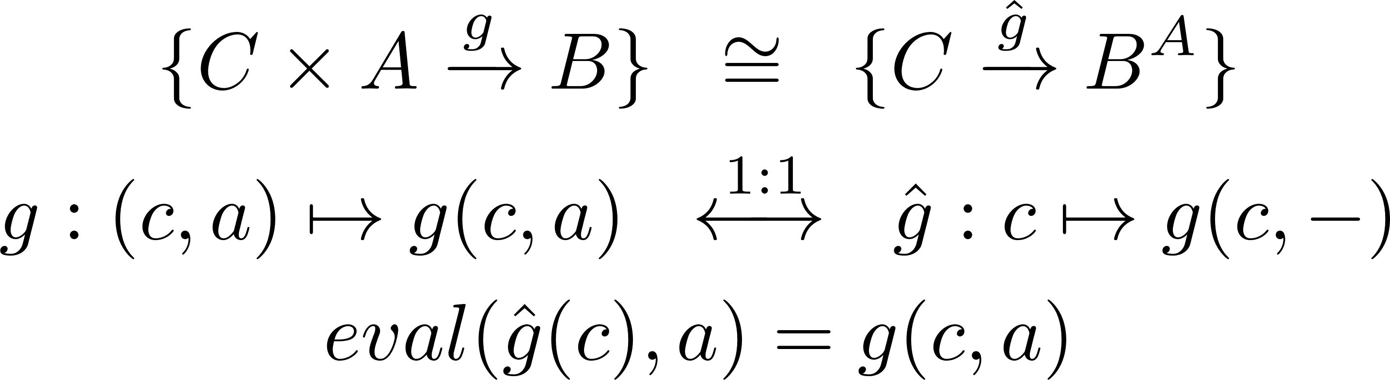
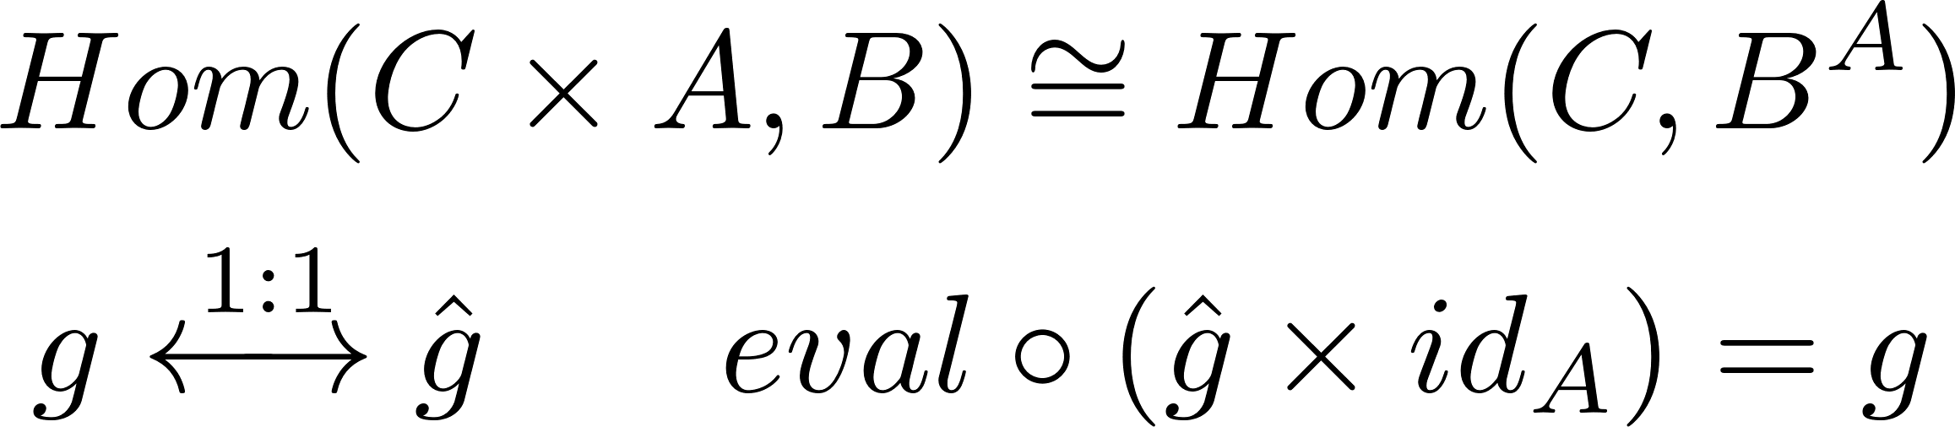


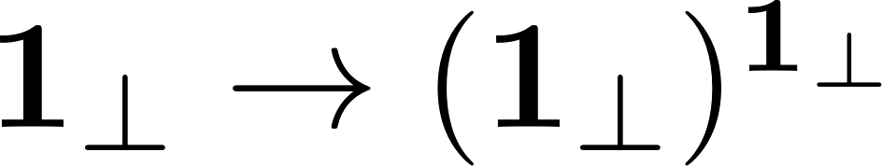
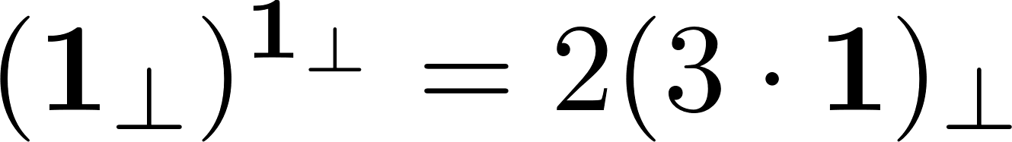
Exponential Object
Exponential Encoding

Slide 14
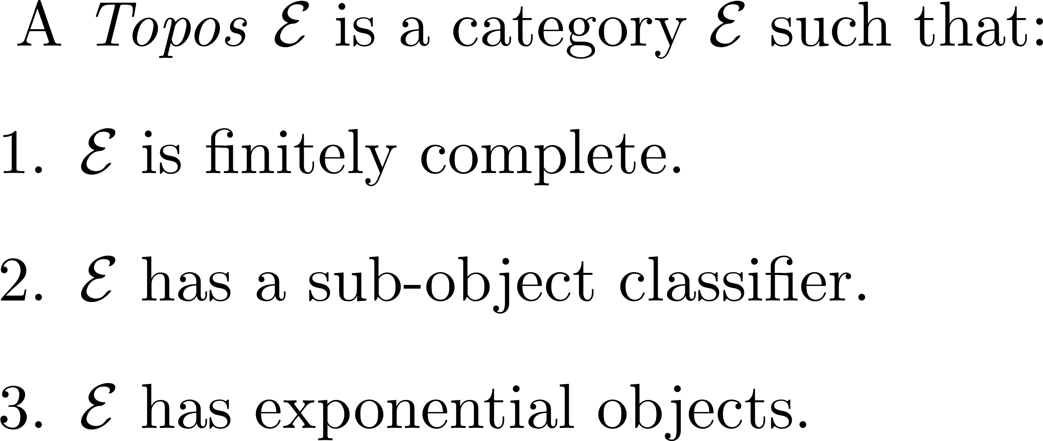
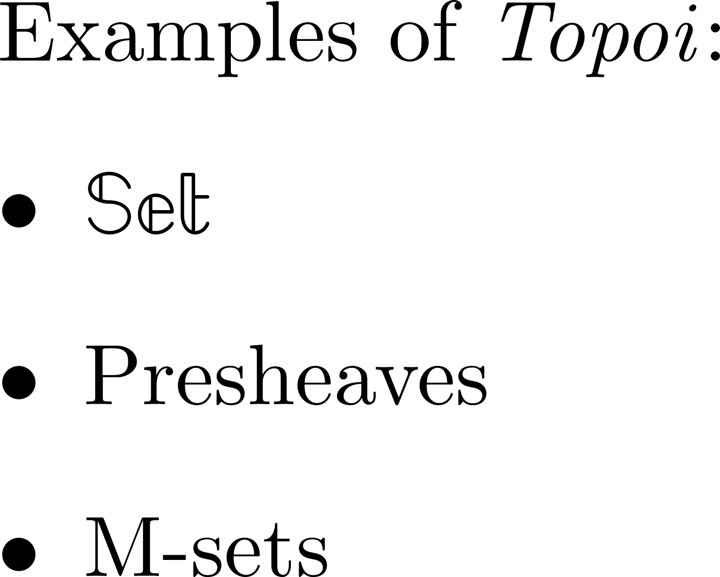

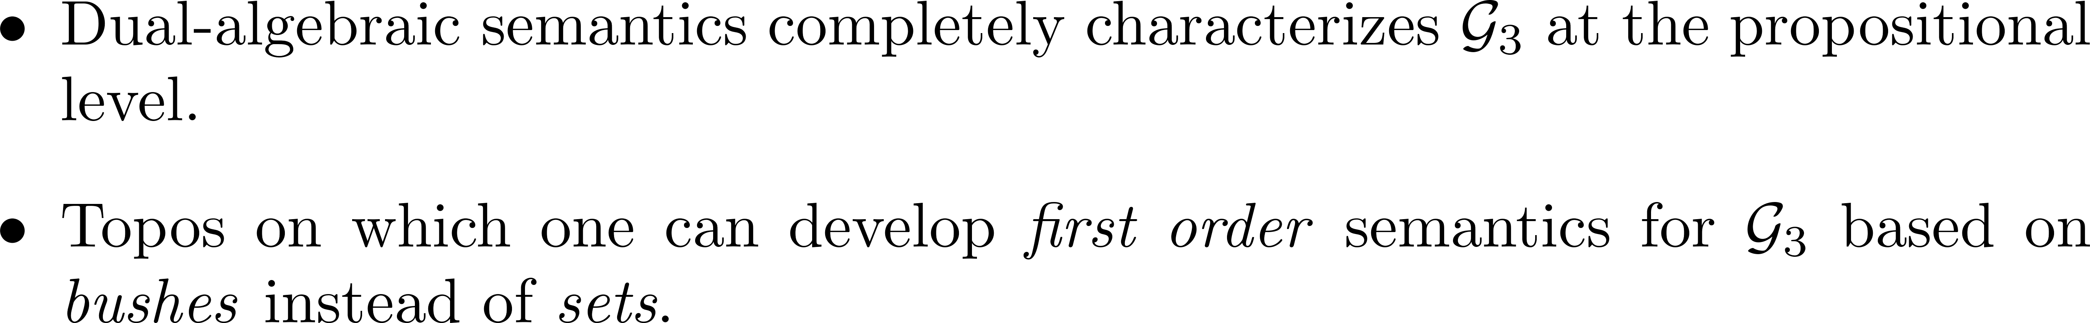
Bushes and Topoi
Topoi are a categorical generalization of sets and provide an ideal framework for non-classical logic.
The category of Bushes is a topos.
Bushes as a best-of-both-worlds semantics

Slide 15
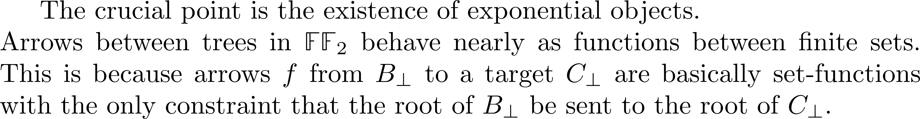

Idea
New result
New counterexample

Slide 16
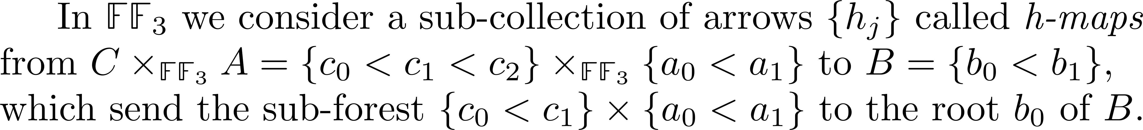
Counter-Example (i)
Lack of uniqueness of adjoint h-maps
“there are 8 h-maps that need to be encoded and at the same time there are 11 branches”

Slide 17
Counter-Example (ii)
Lack of existence of adjoint h-maps
“there are 48 h-maps that need to be encoded and at the same time there are 11 branches”

Slide 18
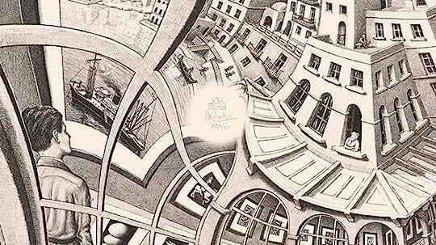
Topoi

Slide 19
The Language of our Topos
Truth constants:
Connectives:

Slide 20
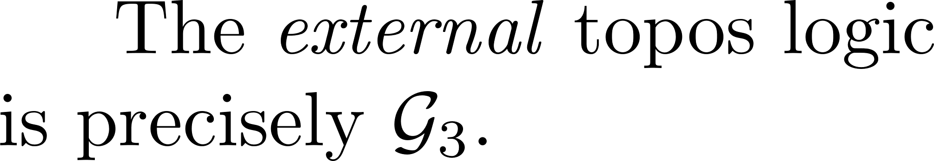
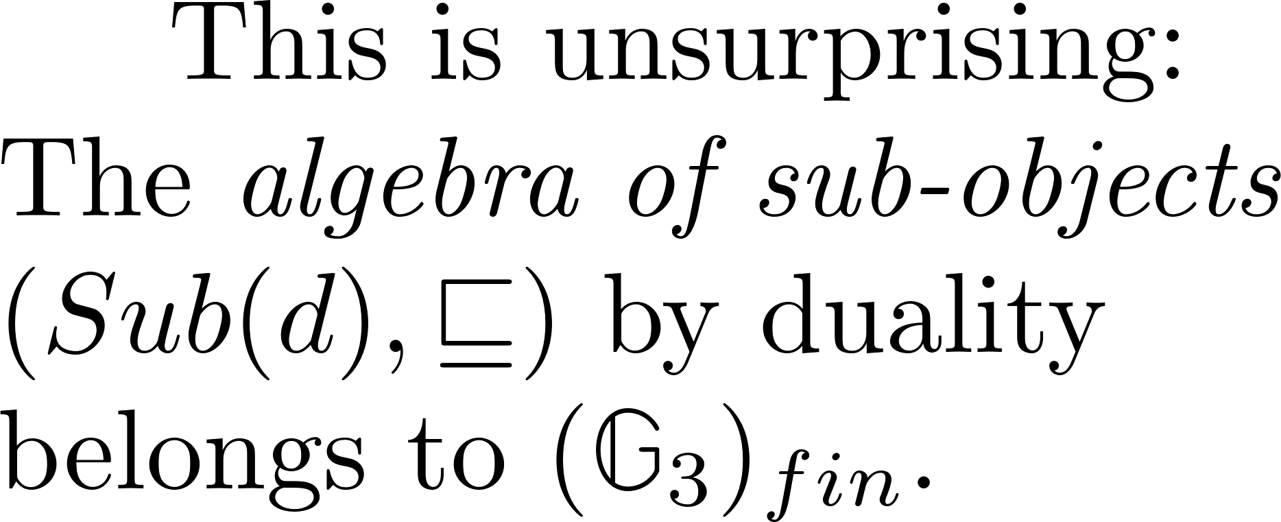
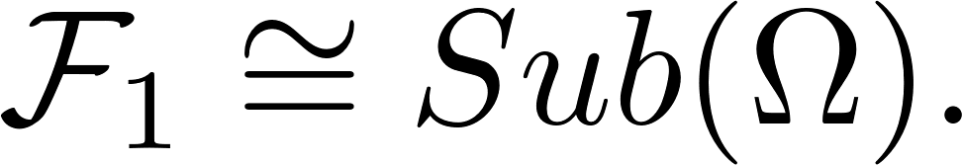
External and Internal Logics
Notice:

Slide 21
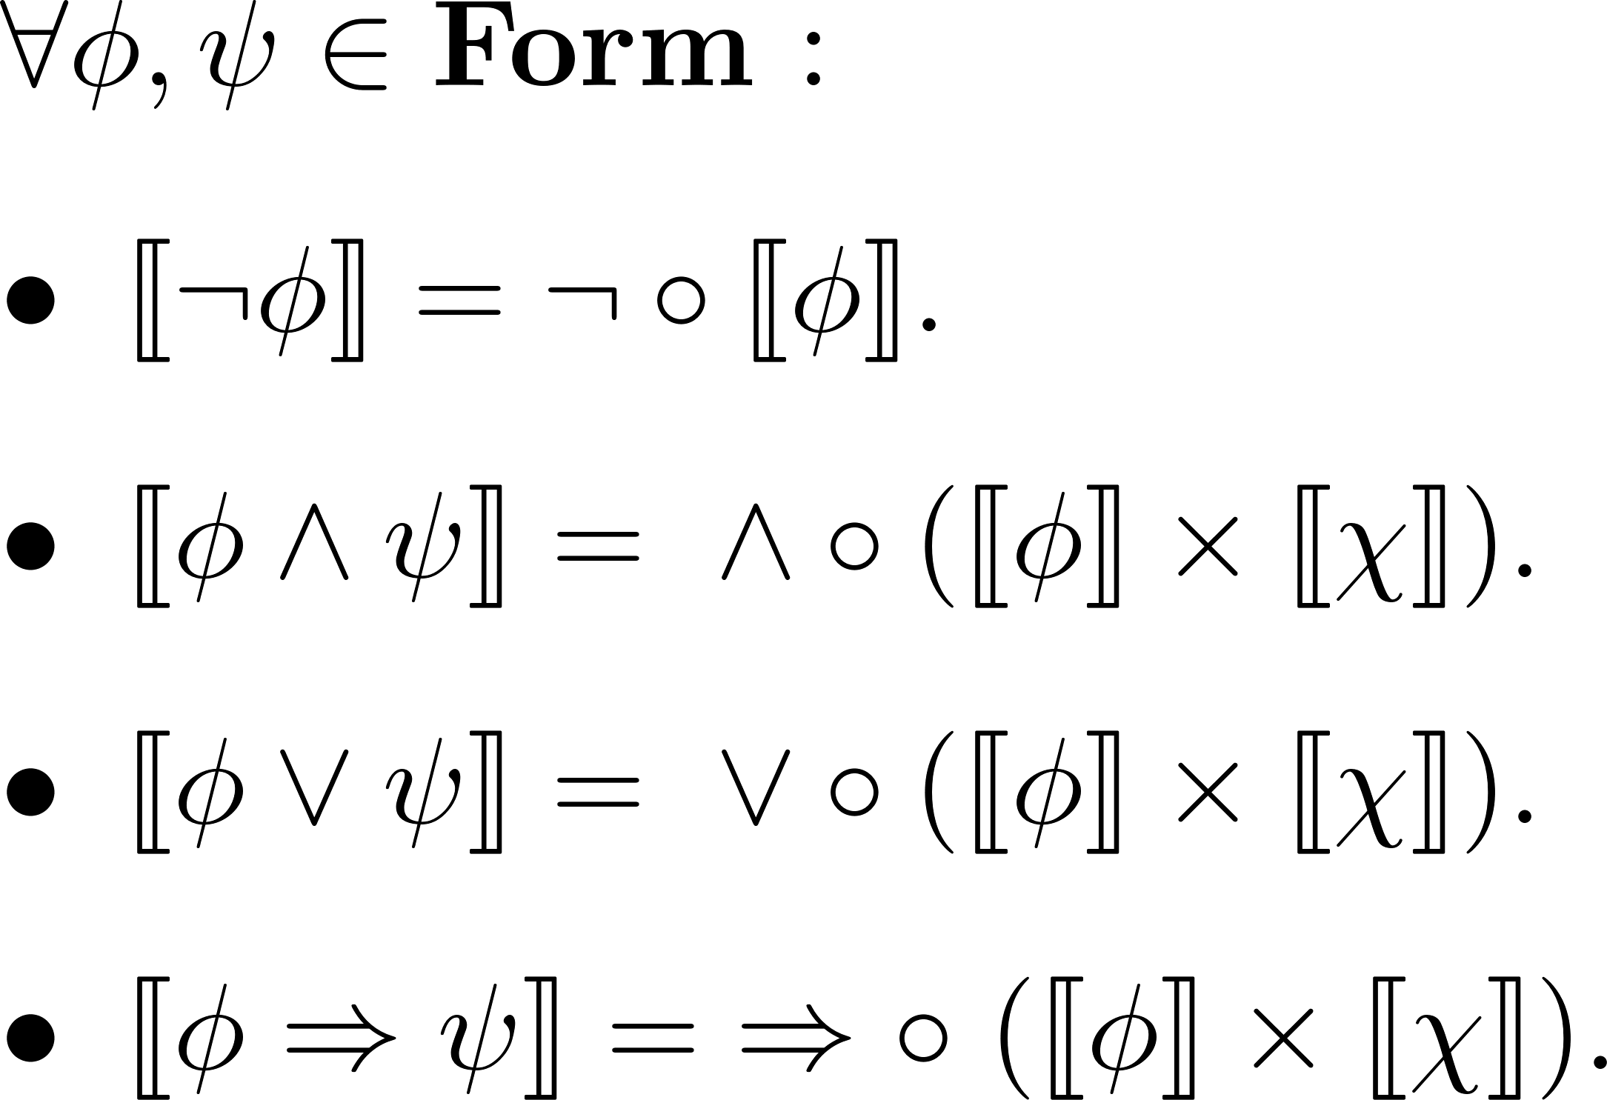
Propositional Layer

Slide 22

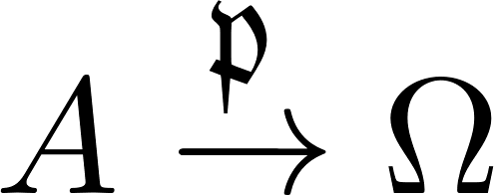
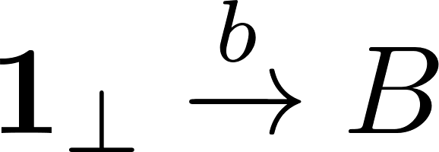
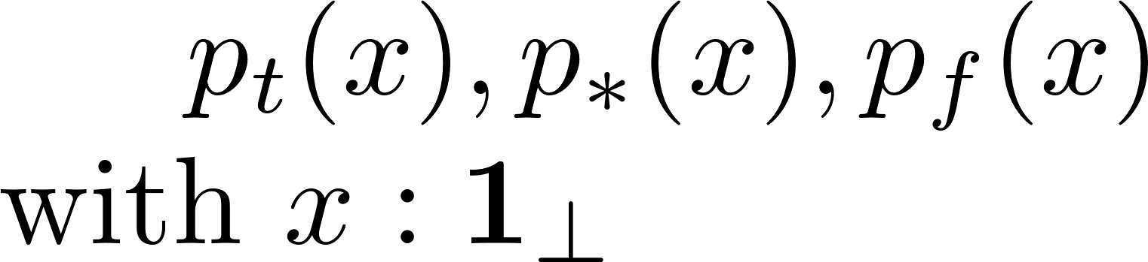


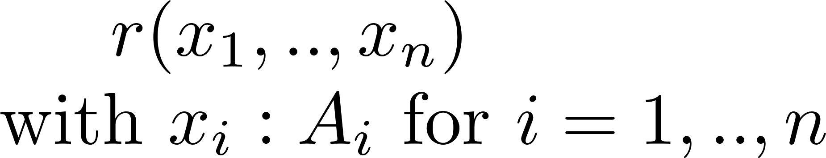
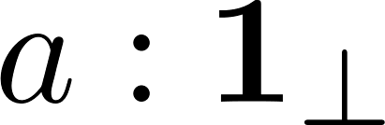
First-Order Logic
Objects as types or sorts
Predicates:
Relations:
Generalized Elements:

Slide 23


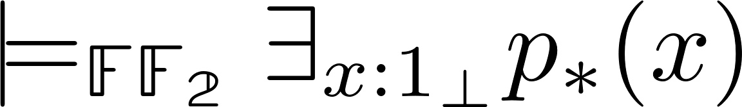
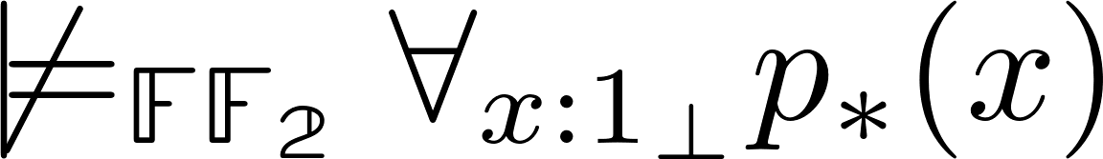
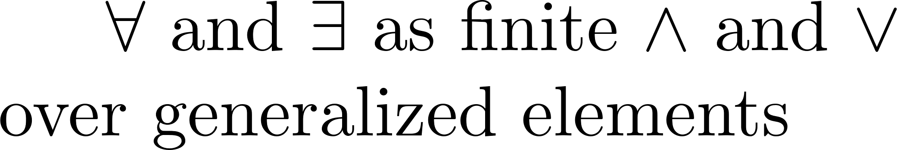
Beth-Kripke-Joyal Semantics
What about quantified formulae?
(First-order level) New result:

Slide 24
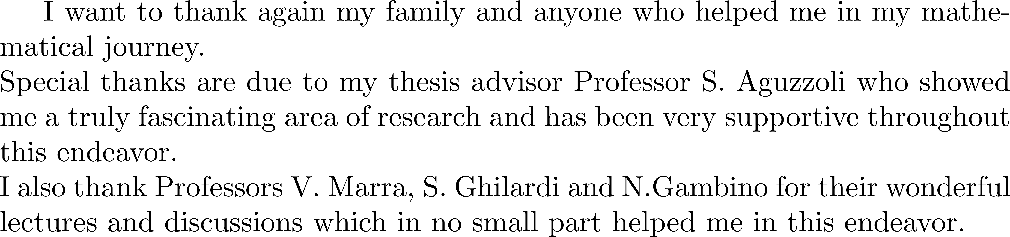
Thanks

Slide 25
References

Slide 26
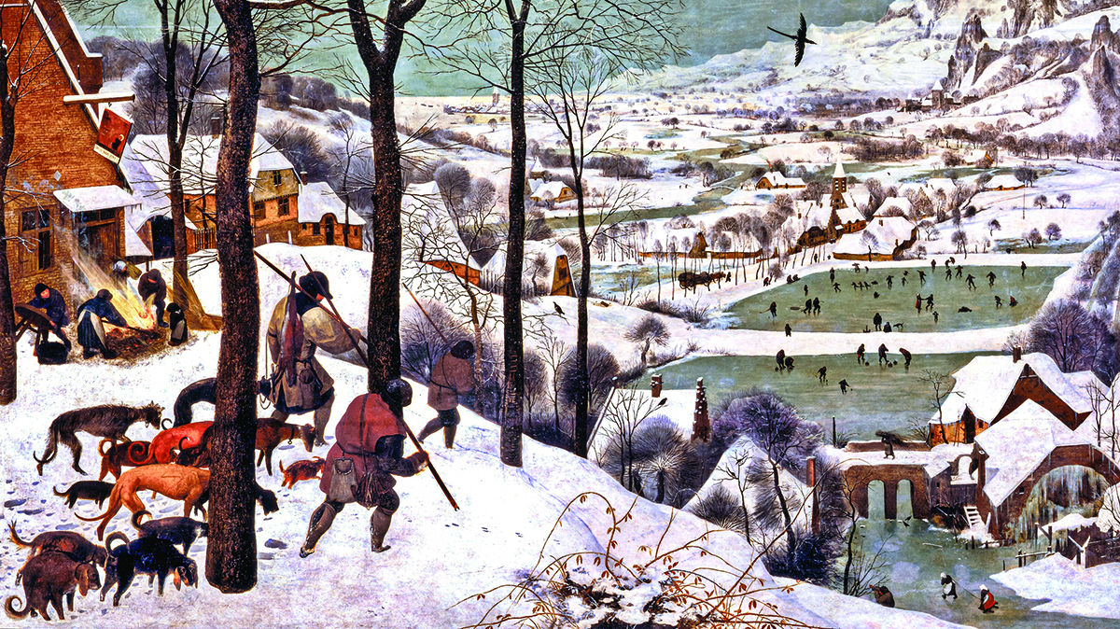
Extra

Slide 27
Gödel-Dummett Logic
Vague or fuzzy propositions : «Antarctica is large»
A Many-Valued or Fuzzy Logic.
Fuzzy inference: «If the credit rating is low then assign a high risk»

Slide 28
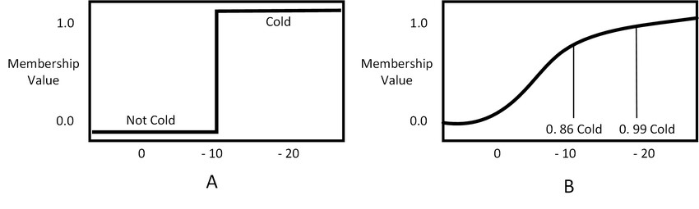

A Non-Classical and Fuzzy World
Fuzzy Logic
Set of truth values given by the real unit interval [0,1].
Truth functionality of the connectives.
Generalization of classical logic:
Introduction of & (strong conjunction) and a new truth function * (t-norm) for & which generalizes conjunction.
Definition of a residuum which generalizes implication.

Slide 29



Fuzzy Logic Applications
From:
Fuzzy Control Systems
in washing machines and
the Sendai Metro
To:
Fuzzy Neural Networks in A.I.

Slide 30

Presheaf and Sheaf Semantics
(Application of known results)

Slide 31





Recap
(Further areas of research)
(Auxiliary Python Code)
Fuzzy Logic
First Order Topos Logic
(Conclusive Remarks)
T
Propositional Layer
NF
F
Sheaf semantics
Duality
Presheaf semantics
Algebras
Forests
Forests as
variable sets
«Best of both worlds»
semantics
(Counter-example)

Slide 32

Further Research and Python Code

